Slide 1
High Availability
Multiple is better

Slide 2

A Great Quote
Everything fails, all the time
knowledge portal

Slide 3
What is High Availability ?
High Availability is a characteristic of the system design which makes resource available even in the case of any component failure in a computer system.
Availability refers to amount of time that the system is in functioning condition
.
General Availability: 100% minus system downtime
Percent of uptime | Max downtime per year | Equiv downtime per day
90% | 36.5 days | 2.4 hours
99% | 3.65 days | 14 minutes
99.9% | 8.76 hours | 86 seconds
knowledge portal

Slide 4

Probability
Events that might disrupt the system’s availability can occur any time, we need to make sure that application is designed to be highly available.
50%
50%
100%
knowledge portal

Slide 5


Important Points
Improving availability leads to increase in cost. Thus it’s important to balance between the cost factor and the availability.
SLA of your organization matters. 90% SLA means 2.4 hours of downtime every day.
knowledge portal

Slide 6
RTO & RPO
Health should always be good

Slide 7

Everything comes at price
High Availability Architecture is driven by your requirements.
An highly available, multi-AZ, fault tolerant infrastructure is certainly possible, however there is cost associated with it.
knowledge portal

Slide 8
Recovery Time Objective
Recovery Time Objective (RTO) is the amount of time frame it takes for you to recover your infrastructure and business operations after disaster has struck.
Sample Example:
If RTO is 3 hours, then one needs to invest quiet good amount of money to make sure DR region is always ready in-case main region goes down due to disaster.
knowledge portal

Slide 9
Recovery Point Objective
Recovery Point Objective (RPO) is concerned with data and maximum tolerance period to which data can be lost.
It helps in determining how well we should be designing the infrastructure.
Sample Example:
If RPO is 5 hours for database, then we should be taking backup of database every five hours .
knowledge portal

Slide 10
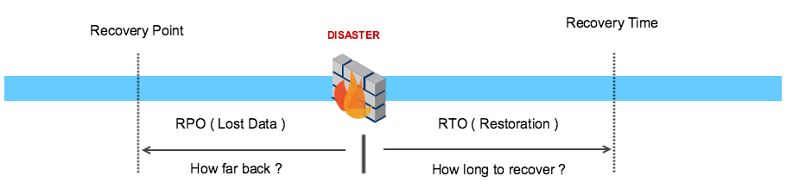
RTO vs RPO
RTO is more broader scope and covers whole business and systems involved while RPO is more directly related to interval of backup to take to avoid data loss.
knowledge portal

Slide 11
Load Balancing in AWS
Let’s Load Balance Traffic in AWS

Slide 12
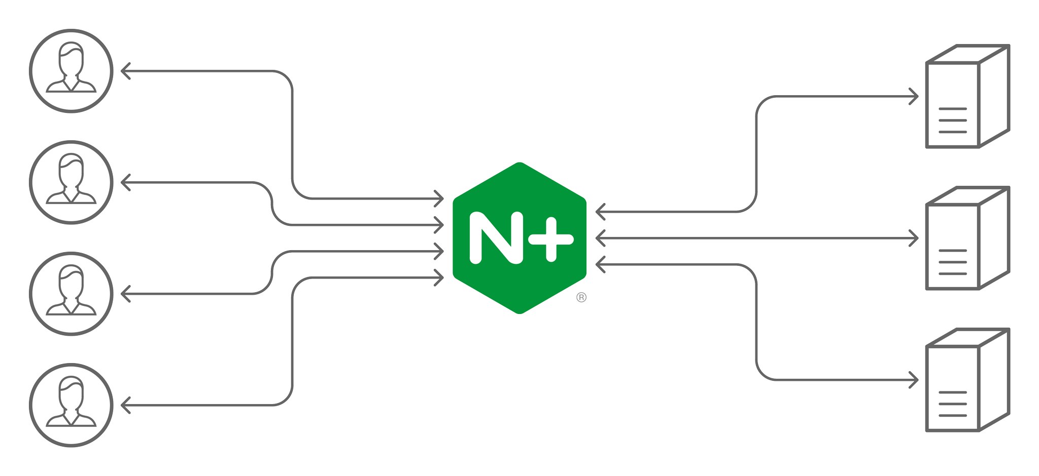
Basics of Load Balancing
There are multiple software and hardware based load balancing solutions available.
Some of the popular ones include Nginx, HA Proxy and others.
knowledge portal

Slide 13
Challenges with Maintaining Load Balancing Solution
If you are using a load balancing solution, various responsibilities falls to customer.
Some of these include:
High-Availability of Load Balancers.
Security.
Performance.
knowledge portal

Slide 14




Basics of Elastic Load Balancing Service
AWS offers managed load balancing solutions for wide variety of use-cases.
These solutions are offered under the Elastic Load Balancing feature.
Tight integration with multiple AWS Services.
Integrations
Auto Scaling
WAF
ACM
Elastic Load Balancing
knowledge portal

Slide 15
Types of Load Balancers
There are 4 primary type of Load Balancer offerings available.
Application Load Balancer
Load Balancer Types
Network Load Balancer
Gateway Load Balancer
Classic Load Balancer
knowledge portal

Slide 16


Application Load Balancers
An Application Load Balancer makes routing decisions at the application layer (HTTP/HTTPS)
/videos
example.com/videos
Application Load Balancer
Server 1
User
/videos | Server 1
/payment | Server 2
Server 2
knowledge portal

Slide 17
Network Load Balancers
A Network Load Balancer makes routing decisions at the transport layer (TCP/UDP/SSL).
It can handle millions of requests per second.
Not all of the applications work on HTTP/HTTPS protocol.
Network Load Balancer
Server 1
Millions of Requests
Server 2

Slide 18
Gateway Load Balancers
Gateway Load Balancers allow you to deploy, scale, and manage virtual appliances, such as firewalls, intrusion detection and prevention systems, and deep packet inspection systems
IPS
Gateway Load Balancer
IPS
Virtual Appliance
knowledge portal

Slide 19
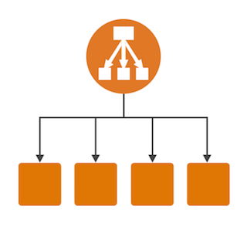
Classic Load Balancers
A Classic Load Balancer makes routing decisions at either the transport layer (TCP/SSL) or the application layer (HTTP/HTTPS).
Previous Generation Load Balancer and not recommended.
TCP
HTTPS
knowledge portal

Slide 20
Summary Slide
Load Balancer | Important Notes
Application Load Balancer | Use when you have websites/applications at L7 (HTTP/HTTPS)
Network Load Balancers | TCP and UDP based applications. Requirement to handle millions of requests per second. Ultra high performance.
Gateway Load Balancer | Use when you have virtual appliances: IDS/IPS Firewalls
knowledge portal

Slide 21
Classic Load Balancers
First generation Load Balancers

Slide 22


Understanding Classic Load Balancers
These are older generation of load balancers.
Provides basic set of features for HTTP, HTTPS, TCP and SSL protocols.
Classic ELB
knowledge portal

Slide 23
Limitation of Classic Load Balancers
Does not support native HTTP/2 protocol.
IP address as targets are not supported.
Path based routing is not supported. (eg: /images should go to server 1 & /php to server 02)
Many Many more …..
knowledge portal

Slide 24
Application Load Balancers
Next generation load balancers

Slide 25
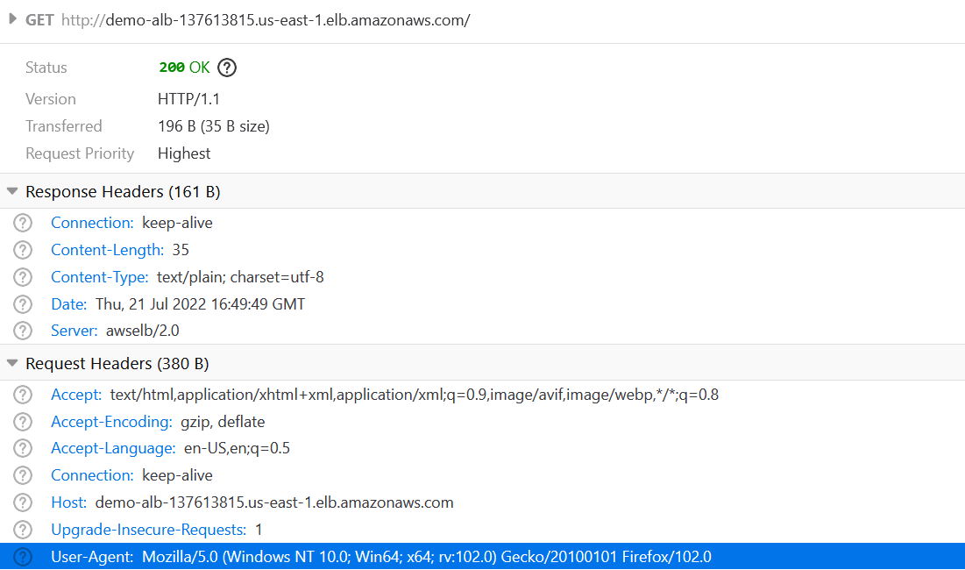
Basics of HTTP Headers
HTTP headers let the client and the server pass additional information with an HTTP request or response.
knowledge portal

Slide 26


Understanding ALB
Application Load Balancer functions at Application layer and support both HTTP & HTTPS
Routing Based On
HTTP Headers
Application Load Balancer
knowledge portal

Slide 27
Path Based Routing
The request are routed based on the URI path.
Path Based Rules | Destination
/videos | Server 1 and 2
/payment | Server 3 and 4
Application Load Balancer
example.com/videos
example.com/payments

Slide 28
Routing Using Host Headers
The request are routed based on the Host Header
Host Header | Destination
example.com | Server 1 and 2
kplabs.in | Server 3 and 4
Application Load Balancer
http://example.com
http://kplabs.in

Slide 29
Web Application Firewall
Next generation firewalls

Slide 30
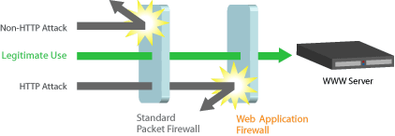
Getting started
We all know about Firewalls and in some way might have worked as well.
Firewall works on the Layer 3 and Layer 4 of the OSI model.
Main aim of firewall: Block malicious and unauthorized traffic.
However what about malicious traffic like SQL Injection attacks, XSS and many more ?
knowledge portal

Slide 31

Introducing WAF
A Web Application Firewall is an application level firewall for HTTP applications.
It applies set of rules for the HTTP based conversations.
WAF generally are deployed to protect against attacks targeted towards application, specifically the ones defined in the OWASP Top 10 metrics.
knowledge portal

Slide 32


WAF Vendors
There are lot of ways in which you can implement WAF and various vendors as well.
Naxsi and Modsecurity are some of the famous open sources ones.
Signal Sciences, Akamai, AWS WAF are some of the commercial vendors that offer WAF related functionalities.
knowledge portal

Slide 33
AWS WAF
Protection against Layer 7 Attacks

Slide 34
Understanding AWS WAF Concepts
I live in a place A in Bangalore and want to meet my friend living in place B in Bangalore.
Rule Statement: If traffic is less on the roads?
Are there any Uber / OLA available?
Rules: If traffic is less AND uber ola available then yes or no
WebACL: Container for all the things + default action.
Association: Zeal
Web ACL
Association
Rules
Rule Statements
knowledge portal

Slide 35
Rule Statements
Rule Statements define basic characteristics that would be analyzed within a web request.
These can be custom-defined or you can use ready-made ones from AWS and marketplace.
Block all the requests which are coming from out of India.
Block request which has a URI Path of /admin
You can even build custom condition based on:
Headers, HTTP Method, Query Strings, URI Path, Geo-Location, Body.
knowledge portal

Slide 36
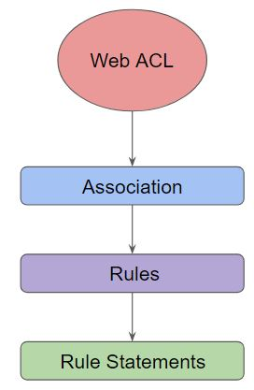
Rules in WAF
We can combine multiple statements into rules to precisely target requests.
WAF provides two primary rule types: Regular Rule & Rate-Based rule
Let’s look into sample regular rule:
If a request comes from 172.30.0.50
Request has SQL-like code
Rules with multiple statements can be AND, OR, NOT
Rate-Based rule = Regular Rule + Rate limiting feature
1 If a request comes from 172.30.0.50
2. If requests exceeds 1000 request in 10 minutes
knowledge portal

Slide 37
Web ACL in WAF
Web ACL is a centralized place that contains the rules, rule statements and associated configuration.
It is used to define the protection strategy.
knowledge portal

Slide 38
Association in WAF
Association defines to which entity WAF is associated to.
WAF cannot be associated with EC2 instances directly.
Support Association: ALB and CloudFront, API Gateway
knowledge portal

Slide 39
Important Pointers
Rule Groups can be configured which has multiple rules that can be used across multiple Web ACLs.
Customers can decide to use ready-made AWS-Managed rules or even rules from AWS Marketplace.
Every Rule has a priority. If a request matches Priority 0 rule, none of the other rules will inspect the request
Pricing Aspect:
Web-ACL ($5 per month), Rule ($1 per month), Requests ($0.60 / 1 million )
knowledge portal

